Slide 1
City of Los Angeles
Department of Public Works
Bureau of Engineering
Asilomar Boulevard Stabilization Project
Coastal Development Permit (CDP) #21-02
PUBLIC HEARING PRESENTATION & TESTIMONY
October 21, 2021
‹#›
Notes:
‹#›
*

Slide 2
Agenda
Welcome
Noah Fleishman, Council District 11
Introductions – Bureau of Engineering
Eileen Schoetzow, Environmental Management Group
Patrick Schmidt/Michael Womack, Geotechnical Engineering Division
Purpose of the Coastal Development Permit Hearing
Project Overview
Project History
Project Objective
Project Description
Project Location
Project Schedule
CEQA Environmental Impact Report
Overview of CA Coastal Act Issues
Overview of Best Management Practices
Public Hearing – Take Public Testimony
Next Steps
‹#›

Slide 3
Purpose of the CDP Hearing
To solicit input regarding the CDP Coastal Issues
Take formal testimony from community regarding issues pertaining to policies of the CA Coastal Act
Please sign in so that we can send you the Notice of Determination once we have made our decision
Please fill out a Speaker Card to make a comment either verbally or in writing

Slide 4
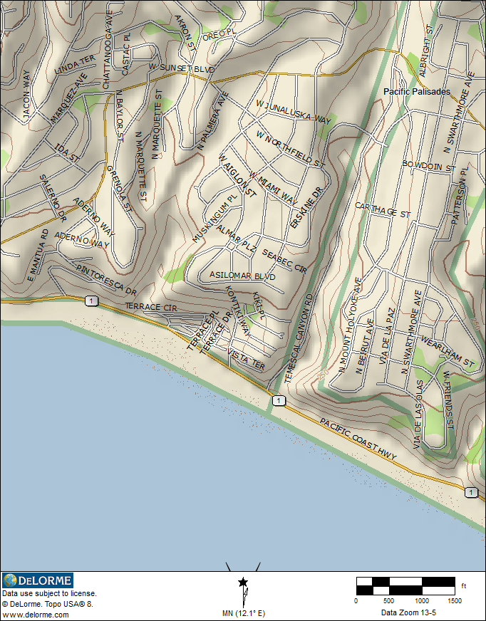
Project Location & Purpose
The fundamental purpose of the Proposed Project is to stabilize the portion of Asilomar Boulevard between Almar Avenue & Wynola Street.
SITE LOCATION
Notes:
‹#›

Slide 5
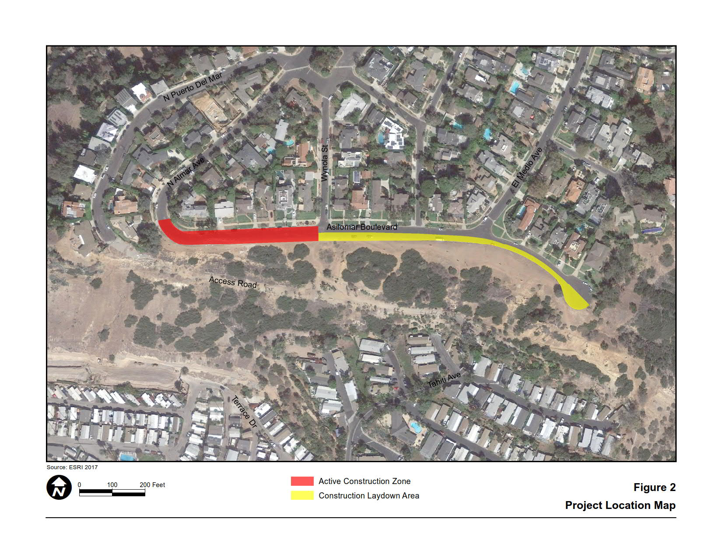
Project Location
‹#›

Slide 6
Project History
A portion of Asilomar Boulevard has a history of distress and settlement
More severe cracks have been periodically filled in with sealers and/or asphaltic concrete
Southern portion of the roadway has also been regraded and resurfaced, however cracks are forming again
‹#›
Notes:
‹#›
*

Slide 7
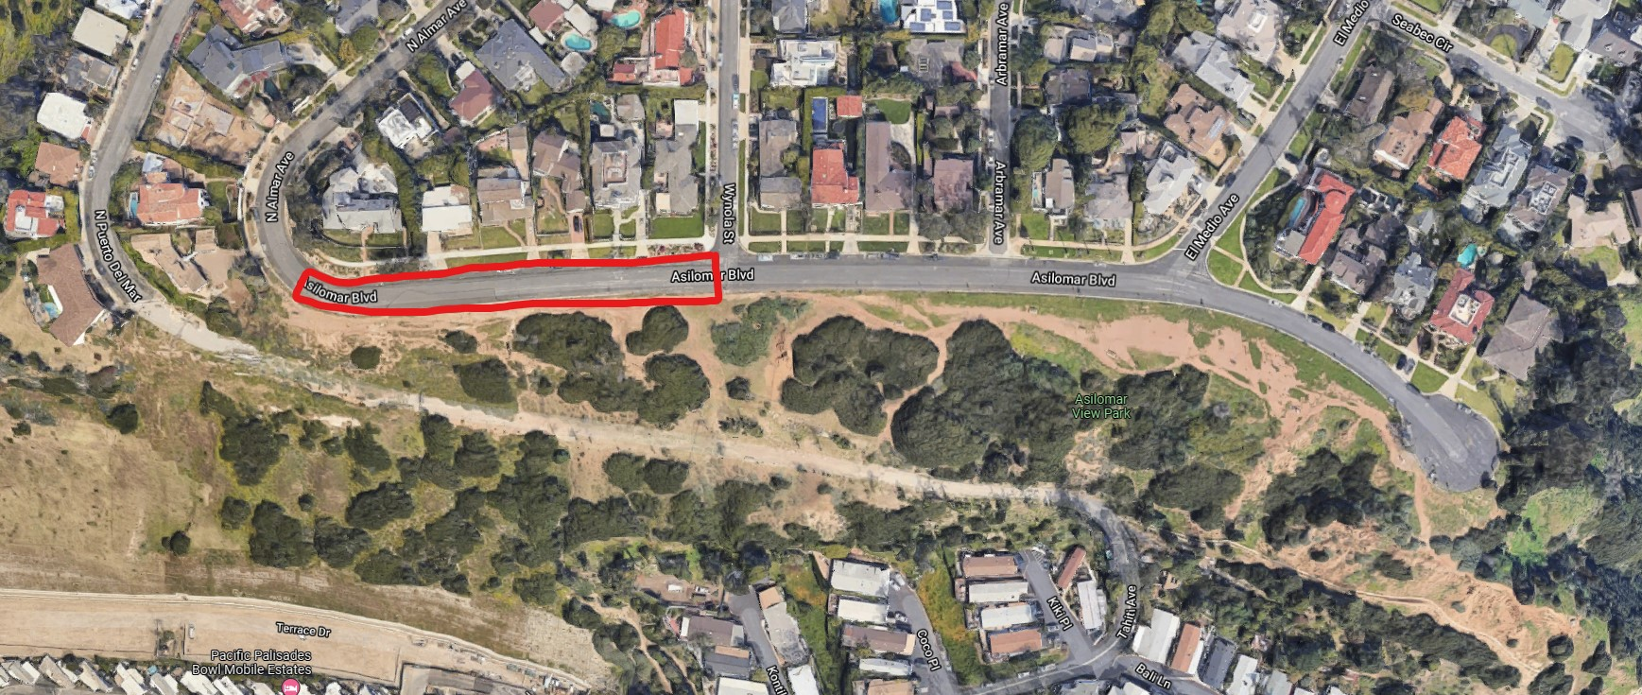
Project Objective
The fundamental purpose of the Proposed Project is to stabilize the portion of Asilomar Boulevard between Almar Avenue & Wynola Street.
‹#›

Slide 8
Project Description
Use a construction method called Cement-Deep Soil Mixing (CDSM), drilling will be performed within the ROW to form subsurface columns which will strengthen the material and stabilize the roadway
Reconstruction of the street
No work on the slope south of the Asilomar Boulevard right-of-way (ROW)
Maintain the natural look of the existing slope south of Asilomar Boulevard
‹#›

Slide 9
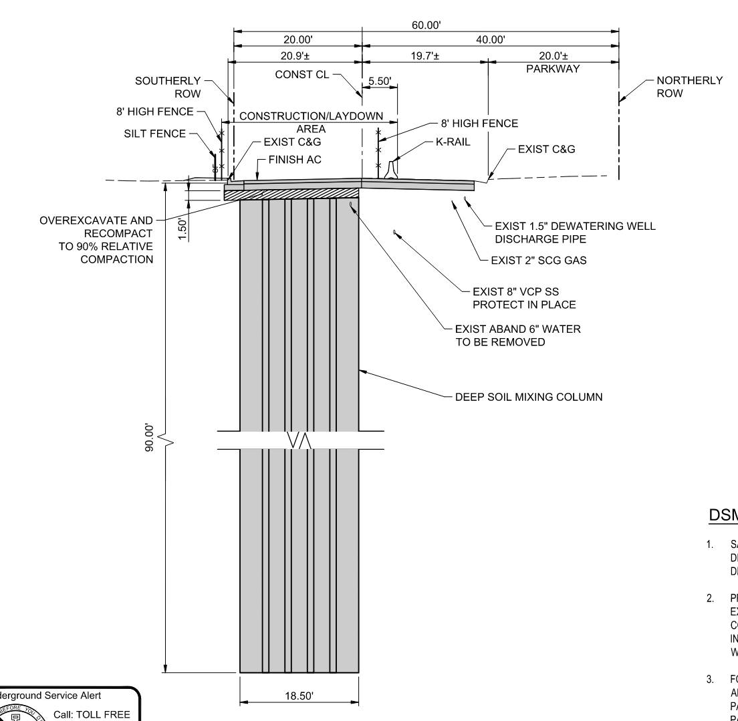
Proposed Project
‹#›
Notes:
‹#›
*

Slide 10
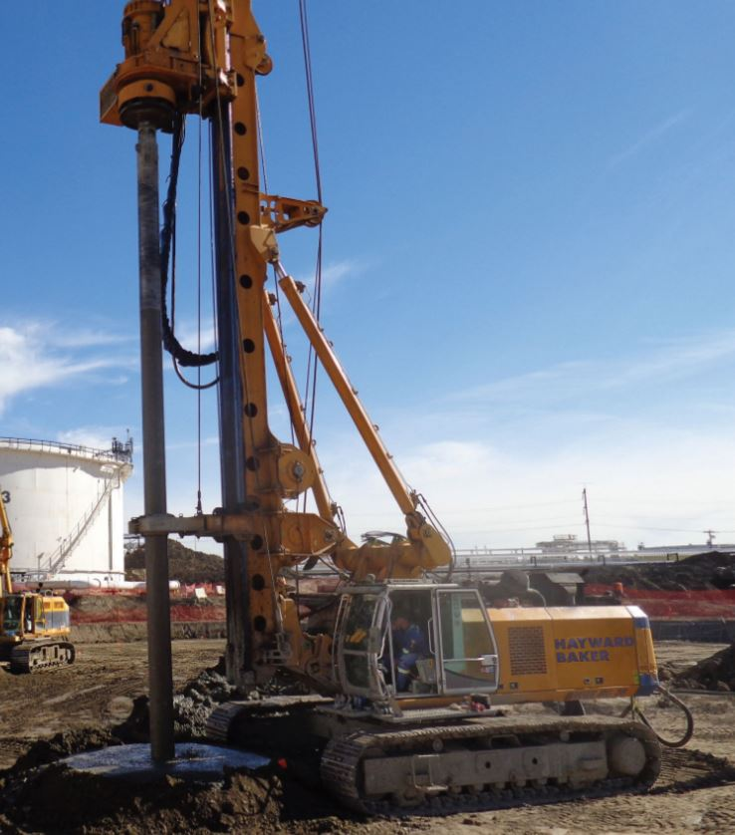
Deep Soil Mixing - Drill Rig
Notes:
‹#›

Slide 11
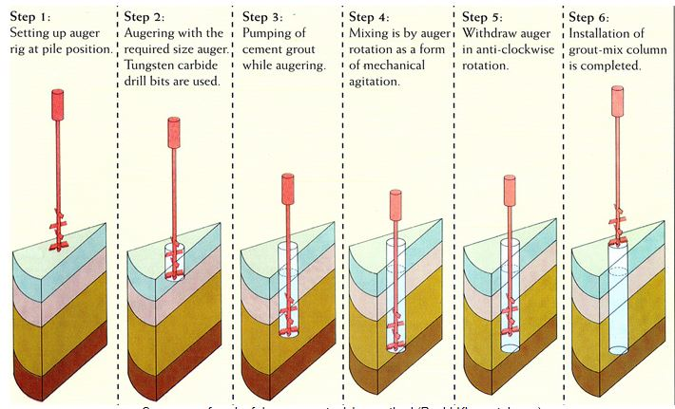
Deep Soil Mixing Process
Step 1:
Setting up auger rig at pile position.
Step 2:
Augering with the required size auger. Tungsten carbide drill bits are used
Step 3:
Pumping of cement grout while augering.
Step 4:
Mixing is by auger rotation as a form of mechanical agitation.
Step 5:
Withdraw auger in anti-clockwise rotation.
Step 6:
Installation of grout-mix column is completed.
Notes:
‹#›

Slide 12
Tentative Project Schedule
Coastal Development Permits
Fall 2021 – Spring 2022
Contract Award Spring 2022
Construction Fall 2022
Construction Duration
Total Construction Period: Approximately 1 Year
Notes:
‹#›

Slide 13
Project Information
BUREAU OF ENGINEERING
Michael Womack
Project Manager
Email: michael.womack@lacity.org

Slide 14
CEQA Environmental Impact Report
Initial Study Prepared & Notice of Preparation was distributed on September 28, 2017
Scoping Meeting was held on October 10, 2017
Draft EIR Public Meeting was held on May 29, 2018
An Environmental Impact Report, SCH No. 2017091076, was certified by the Los Angeles City Council on June 09, 2021
Notes:
CEQA PROCESS
Required for all discretionary actions
Informs public & decision makers
Feasible ways to avoid, reduce, and/or mitigate impacts
Considers alternatives
Discloses significant & unavoidable impacts
Opportunity to comment on the environmental issues

Slide 15
Final EIR – Key Environmental Issues
Aesthetics
Air Quality
Biological Resources
Cultural Resources
Geology/Soils
Greenhouse Gas Emissions
Hydrology/Water Quality
Noise
Paleontological Resources
Recreation
Transportation/Traffic
Tribal Cultural Resources
Effects found not to be Potentially Significant
Cumulative Impacts
Project Alternatives
No Project Alternative & Project Alternatives
‹#›
Notes:
Effects found not to be potentially significant:
1) agriculture and forestry; 2) hazards and hazardous materials; 3) land use and planning; 4) mineral resources; 5) population and housing; 6) public services; and, 7) utilities and service systems.
‹#›
*

Slide 16
No Impact Environmental Issues
Agriculture & Forestry
Hazards & Hazardous Materials
Land Use/Planning
Mineral Resources
Population/Housing
Public Services
Utilities/Service Systems
‹#›

Slide 17
CA Coastal Act - Coastal Issues
Per the California Coastal Act, these Coastal Issues include:
Article 2 - Public Access
Article 3 - Recreation
Article 4 - Marine Environment
Article 5 - Land Resources
Article 6 - Development
Article 7 - Industrial Development

Slide 18
CA Coastal Act - Coastal Issues
DURING CONSTRUCTION PERIOD ONLY
Article 6, Development
Section 30251 Scenic and visual qualities
Section 30253 Minimization of adverse impacts
Notes:
The Staff report covers this topic.

Slide 19
Best Management Practices
As part of the approved Notice of Exemption, best management practices (BMP) related to the following resources are required during construction:
Aesthetics
Air Quality
Cultural Resources
Hydrology
Noise
Traffic

Slide 20
Aesthetics
Construction Staging/Stockpiled Materials and Equipment
Nighttime Construction Activities
Air Quality
Tier 3 Construction Equipment

Slide 21
Cultural Resources
Archaeological and/or Tribal Cultural Resources
Hydrology
Fifteen (15) Best Management Practices
Noise
The contractor shall establish a Noise Complaint and Resolution line
Designate a noise monitor to monitor noise levels during construction, and
Comply with the City of Los Angeles Noise Ordinance No. 144,331.
Notes:
According to the City of Los Angeles General Plan Framework EIR, the Project site is located within Invertebrate Paleontological Resource Sensitivity Area. No impact to these resources is anticipated, however, the contractor shall comply with the following BMPs:

Slide 22
Noise
Prepare and Implement a Construction Noise Control Plan
Construction Hours
Noise Barriers
Quiet Construction Equipment
Construction Equipment Noise Compliance
Proper Maintenance
Equipment Mufflers, Shrouds and Shields
No Idling
Minimum Use of Audible Safety Warnings
Generator and Compressor Placement
Construction Equipment Storage
Implement Ground-borne Vibration Control Measures to Reduce Construction-generated Vibration
Notes:
The Los Angeles Bureau of Engineering (LABOE) and Contractor shall develop a Noise Control Plan that includes the implementation of various noise reduction measures during construction, as needed, including but not limited to the following:

Slide 23
Traffic
Coordination with Emergency Service Providers
Coordinate with emergency service providers (police, fire, ambulance and paramedic services) to provide advance notice of any lane closures, construction hours and changes to local access and to identify alternative routes where appropriate.

Slide 24
Public Testimony Regarding CA Coastal Act - Coastal Issues
Please keep your comments limited to the following Coastal issues:
Article 2 - Public Access
Article 3 - Recreation
Article 4 - Marine Environment
Article 5 - Land Resources
Article 6 - Development
Article 7 - Industrial Development

Slide 25
COMMENT PERIOD
All written comments must be received on or before
4:00pm on October 22nd, 2021
to be considered, prior to the decision on the case.
Email Comments to: Eileen.Schoetzow@lacity.org
Mail Comments to: Eileen Schoetzow
City of LA, BOE/EMG
1149 S. Broadway Ave.
Los Angeles, CA 90015
Notes:
Now the comment period starts. We will take specific testimony on your comments related to Coastal Issues.
All written comments must be received on or before 5:00pm on October 25th, 2017 to be considered, prior to the decision on the case.
Speaker cards are available in the back
No more than two (2) minutes to comment
William Jones will have two cards, one yellow and one red.
He will hold up the yellow when time has almost expired and will hold up the red when time is up.

Slide 26
THANK YOU FOR ATTENDING
ENJOY YOUR EVENING!
‹#›
Notes:
‹#›
*

