Slide 1
Pacific Palisades Community Council
March 27, 2025

Slide 2
Welcome
l
Division of School Operations
Dr. Debra Bryant
Executive Director

Slide 3
Welcome
Board District 4
Allison Holdorff
Senior Advisor & District Director

Slide 4
Campus Reconstruction Update
Marquez ES, Palisades ES and Palisades Charter HS
Facilities Services Division
Issam Dahdul
Director of Facilities Planning and Development

Slide 5
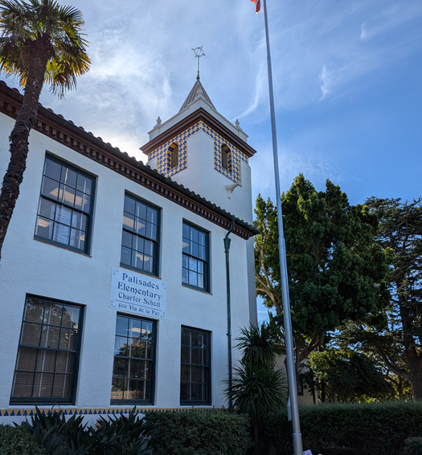
Facilities Presentation Overview
Introduction
Preliminary Timeline
Site Overview of Each School
Preliminary Rebuilding Plan of Each School

Slide 6
Preliminary Timeline
Fire Debris Removal: Underway
Removal of fire debris structures anticipated to complete in March
Facility Assessments: Underway - Summer 2025
Environmental Assessments and Remediation
Infrastructure assessment (electrical, water, waste, etc.)
Building and Building Systems (i.e. HVAC) Assessments
Building and Infrastructure Replacement and Repairs: TBD
Anticipated timeline pending assessments – report back in May
Interim Classrooms: Anticipated 2025
Installation of temporary portable classrooms with admin/support spaces
Completion of Permanent Facilities:
Planning, Design, and Construction of Proposed Permanent Facilities
Notes:
Clean-up, Repairs, and Installation of Interim Buildings
Timeline for Completion will be known once assessments are completed in May 2025

Slide 7
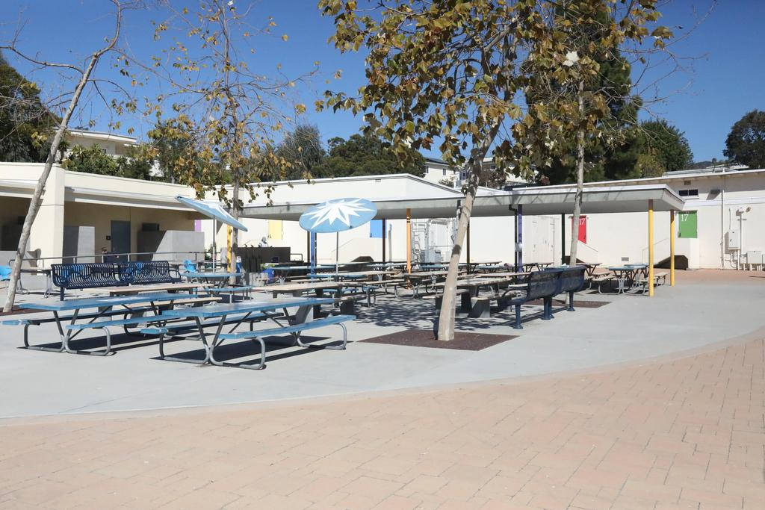
Marquez Elementary School
Site Overview
Enrollment: 312 Students (at start of 24/25 School Year)
Site Acreage: 7.73 Acres
Campus Facilities: All Deemed Total Loss
37 Classrooms primarily in portable bldgs
Food Service and Outdoor Lunch Area
Administration
Auditorium
Playground
Staff Parking Area

Slide 8
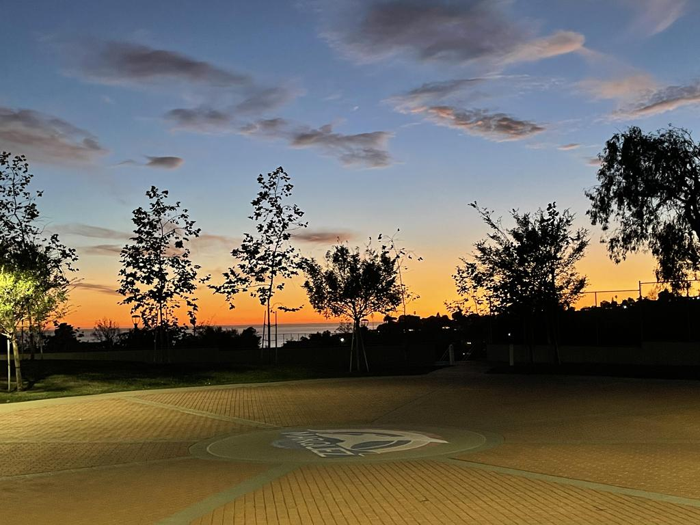
Marquez Elementary School
Preliminary Rebuilding Plan
(* Pending Community Feedback)
Commitment to Rebuild: Complete rebuilding to pre-fire enrollment
Permanent Campus Proposal*
General, TK/K, and specialty classrooms
Food service and lunch shelter
Multi-purpose room
Administrative support areas
Hardscape and Landscape Areas
Interim Campus Proposal*
Construct interim campus
Restore school at Marquez ES during the design and construction of the permanent rebuild.

Slide 9
Marquez Elementary School
Preliminary Rebuilding Plan
Preliminary Campus Development Zones

Slide 10
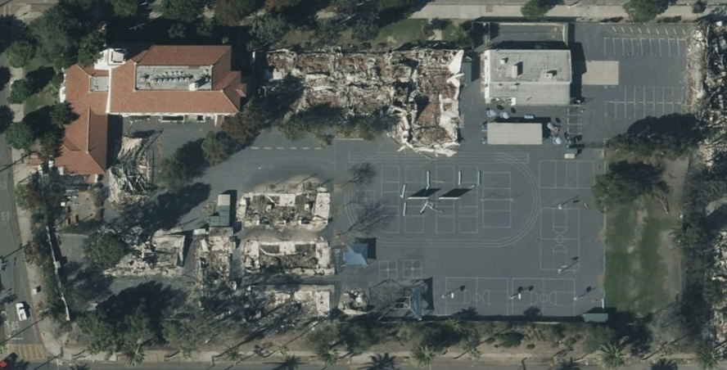
Palisades Elementary School
Site Overview
Enrollment: 410 Students (at start of 24/25 School Year)
Site Acreage: 4.21 Acres
Fire Damage Inventory:
17 Classrooms (~70% of total)
Administrative support spaces
Multipurpose room
Storage facilities
Play equipment and shade structures
Landscaped area and trees
All fire-damaged facilities will be rebuilt and repaired

Slide 11
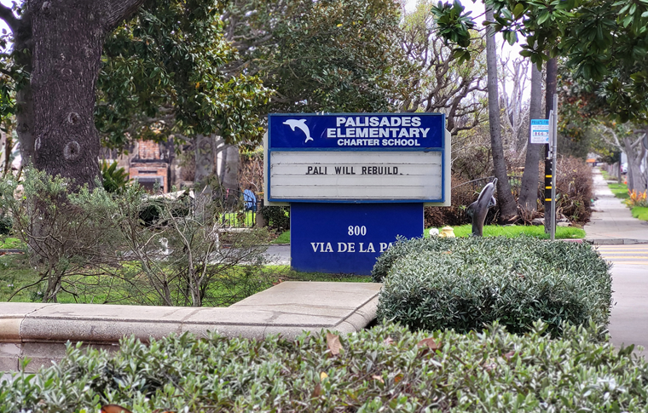
Palisades Elementary School
Preliminary Rebuilding Plan
(* Pending Community Feedback)
Permanent Replacement Facilities*
General, TK/K, and specialty classrooms
Multipurpose room
Administrative support areas
Play equipment and shade structures
M&O spaces
Hardscape and landscape areas
Proposed Interim Classrooms*
Provide temporary portable classrooms for student use until the permanent classroom replacement is completed

Slide 12
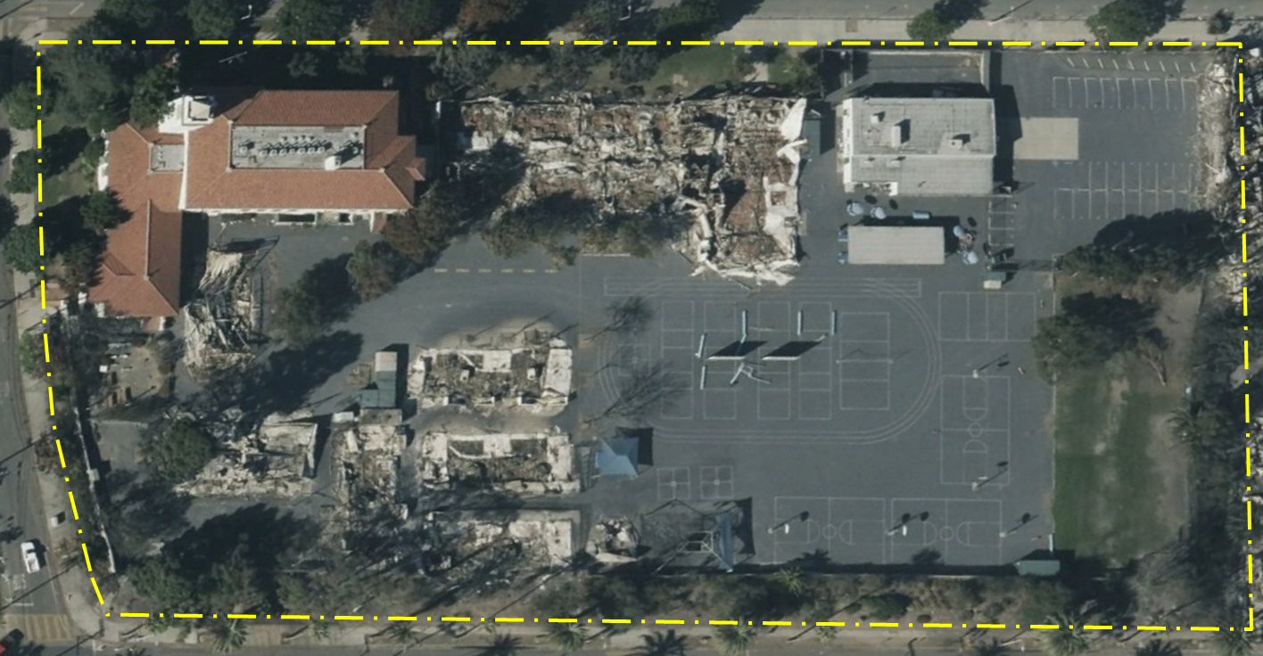
Palisades Elementary School
Preliminary Rebuilding Plan
Preliminary Campus Development Zones

Slide 13
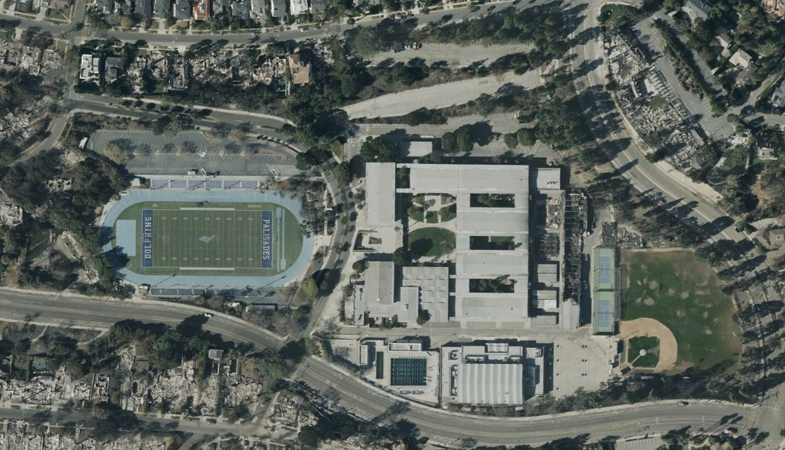
Palisades Charter High School
Site Overview
Enrollment: 2,907 Students (at start of 24/25 School Year)
Fire Damage Inventory:
21 Classrooms (~30% of total)
Administrative support space
Synthetic track and field
Storage facilities
Landscaped area and trees
All fire-damaged facilities will be rebuilt and repaired

Slide 14
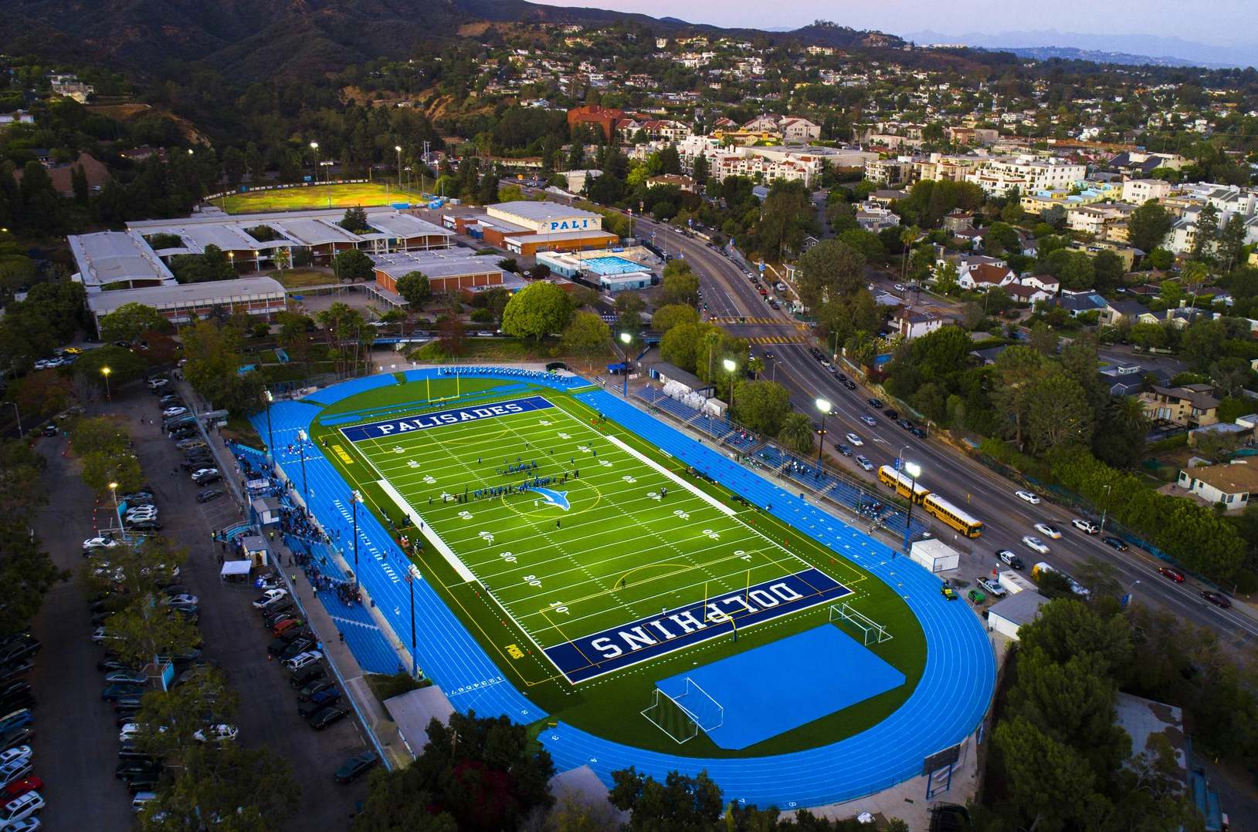
Palisades Charter High School
Preliminary Rebuilding Plan
Permanent Replacement Facilities
New general and specialty classrooms
Administrative support areas
Track and field
Hardscape and landscape improvements
Proposed Interim Classrooms
Provide temporary portable classrooms for student use until the permanent classroom replacement is completed

Slide 15
Palisades Charter High School
Preliminary Rebuilding Plan
Preliminary Campus Development Zones

Slide 16
Environmental Safety Update
Office of Environmental Health & Safety
Carlos A. Torres, Director

Slide 17
Efforts to Safeguard Schools
Inspected all schools for ash and soot
Enhanced cleaning at schools closest to Palisades Fire
Focus on HVAC and provided air purifiers
All work was performed following agency guidelines
LA Unified consulted with public health agencies including California Office of Emergency Services, the California Department of Education, and California Department of Public Health to share our efforts to safely reopen schools.
Additional targeted sampling and screening conducted

Slide 18
Ongoing Recovery Efforts
Agency Cleanup Activities
Palisades HS & Marquez ES are completed
Palisades ES is in progress
Plan for Remaining Buildings
Plan for Interim Campus Construction
Safety Measures When Students Return

Slide 19
Agency Cleanup Activities
Department of Toxic Substances Control
Environmental cleanup of hazardous materials, such as lithium batteries, paint, and other chemicals was completed for Palisades HS, Palisades ES and Marquez ES
United States Army Corps of Engineers (USACE)
Remove all fire related debris within footprint of the burn area
Remove the top 6 inches of soil within the footprint of destroyed buildings
Los Angeles Unified requested USACE to prioritize the cleanup of surrounding properties

Slide 20
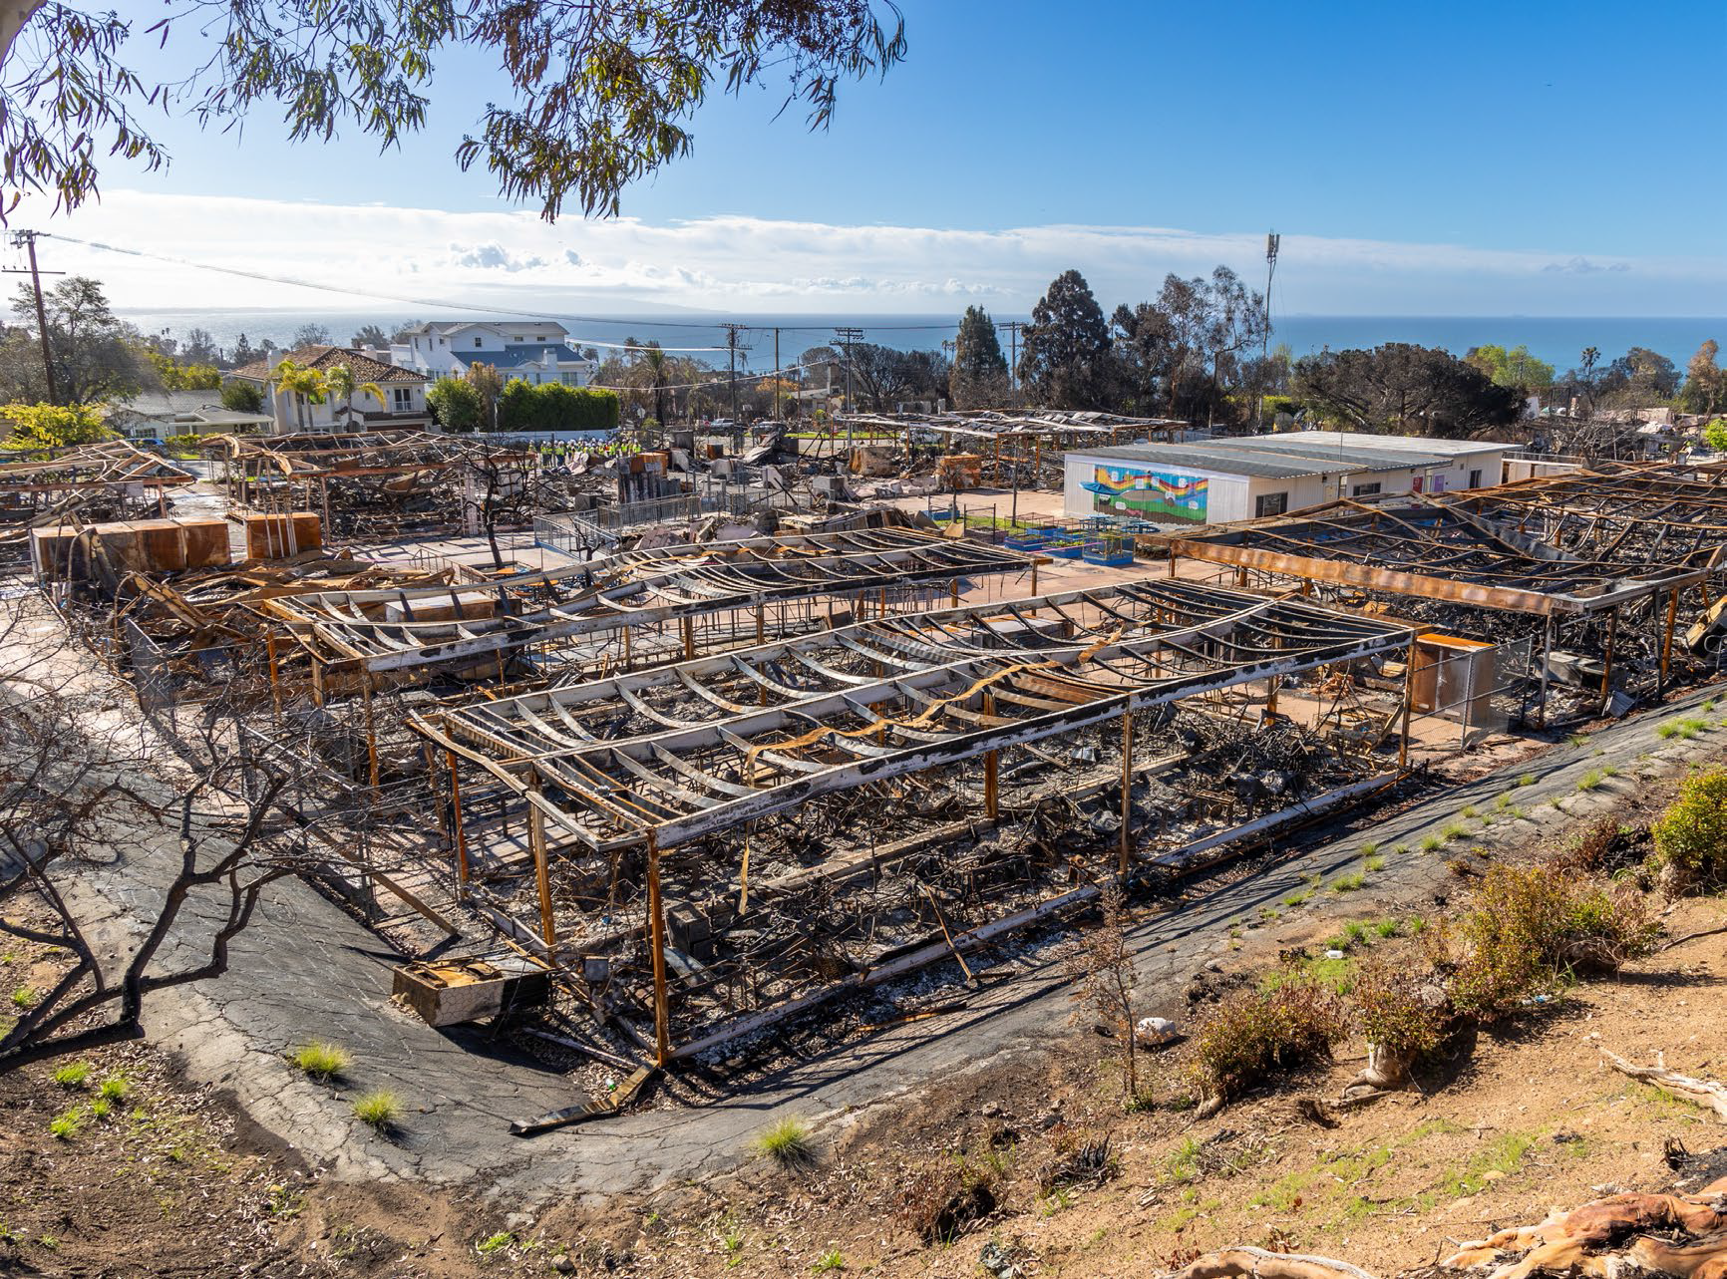
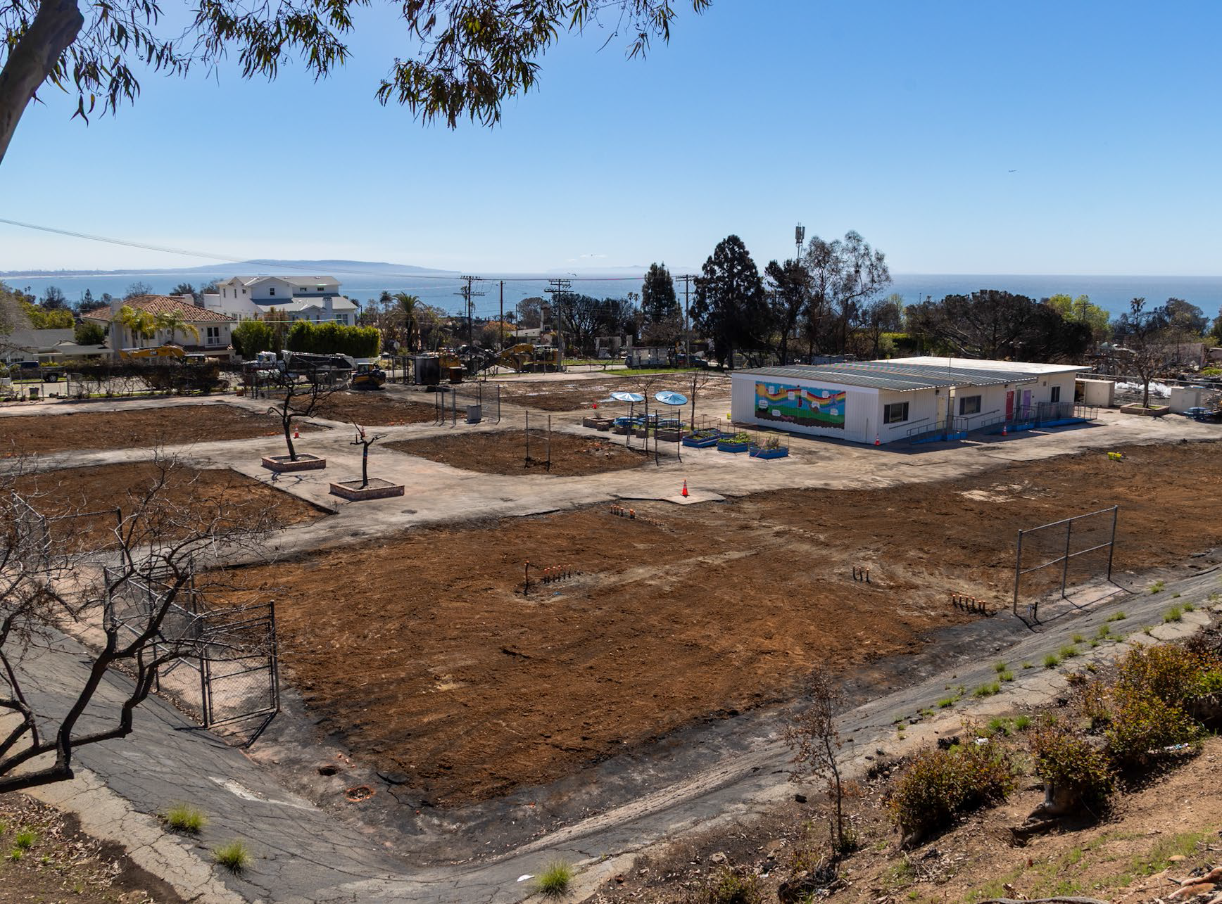
Before and After – Marquez ES
March 02, 2025
March 07, 2025

Slide 21
Plan for Schools with Buildings Damaged by Palisades Fire
Steps for Remaining Impacted Buildings
Evaluate and conduct abatement of asbestos, and lead based paints,
Remove ash and other debris in the buildings,
Clean building surfaces, including HVAC ducts and exterior
Conduct environmental sampling, including wipe samples to ensure the buildings are cleared out of fire related contaminants, including asbestos, lead, ash and others
Steps for New Interim Buildings
Oversee contractors to ensure that soil handling and disposal requirements are being conducted according to federal, State, local regulations and guidelines.
Conduct air monitoring during construction

Slide 22
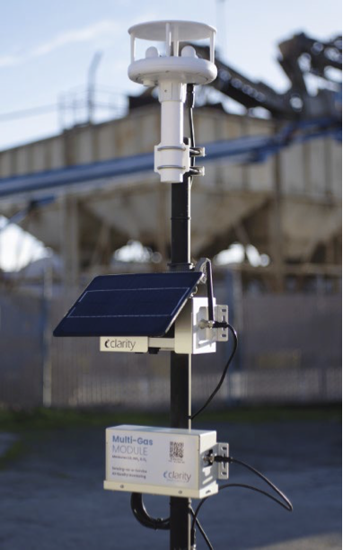
Safety Measures When Students Return
Continue Environmental Monitoring
LA Unified Know Your Air Network
Monitor for air quality (PM2.5) in real time with online public access
Enhance by adding sensors for measurement of PM10 and met data
Create program to monitor air quality during community recovery efforts

Slide 23
Long Term Commitments
Ongoing meetings with the Palisades Community and LAUSD to gather feedback regarding the preliminary rebuild plans of the impacted schools. Tentative date of next meeting 4/9/25
The preliminary reconstruction project will be presented to the Bond Oversight Committee and the Board of Education in the Spring of 2025
Sustained instructional and socioemotional support for educators, students, and families
Continue to provide timely updates

Slide 24
Gathering Feedback
We appreciate you taking the time to listen to the presentation. Now, we'd like to hear from you.
Do you have any questions about the LAUSD school rebuilding efforts?
What else should LAUSD consider as it develops plans for long-term reconstruction of these sites?

Slide 25
Q & A

Slide 26
For More Information:
Online updates on our website:
schoolupdates.lausd.org
Follow @LASchools and @LASchoolsWest

